Slide 1
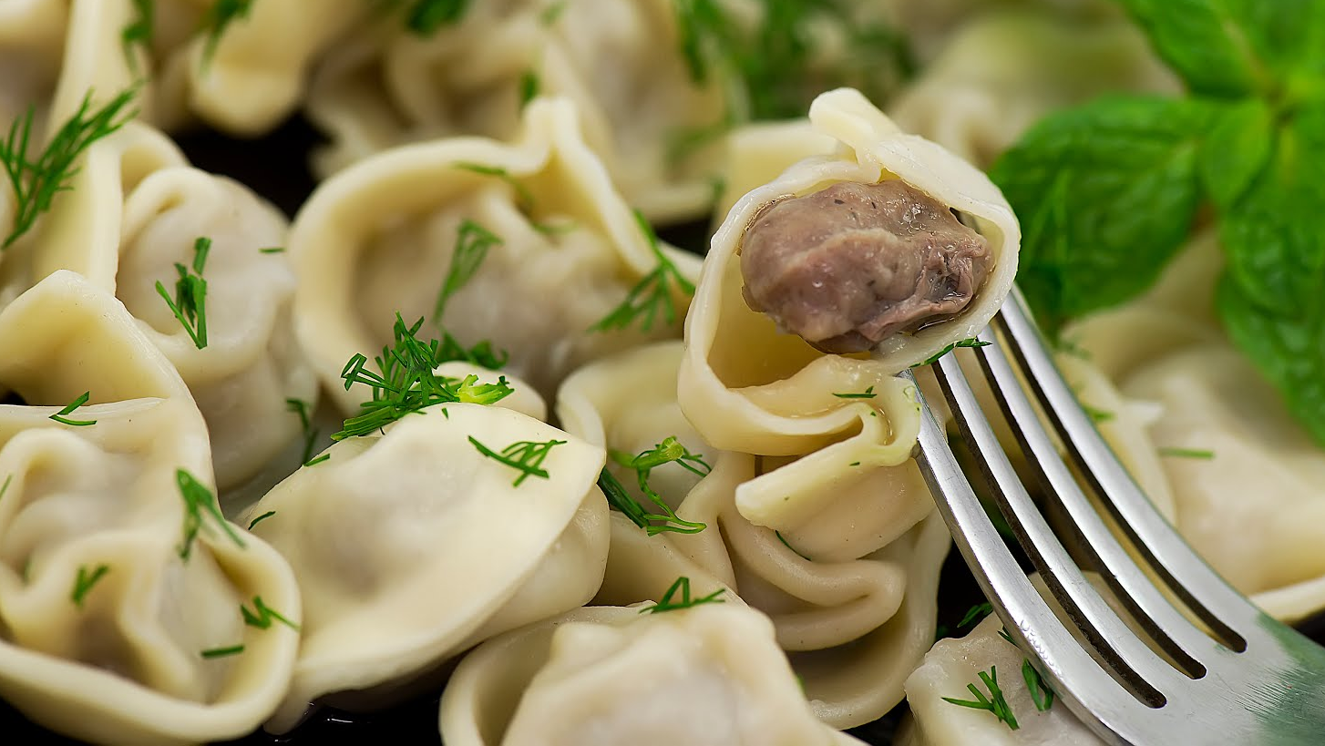
Pelmeni

Slide 2
similar to – похожий
parcel – свёрток
instead of – вместо
dough – тесто
come up with – придумывать
keep frozen – хранить замороженным
flavour – вкус
hunter – охотник
go off – портиться
pork – свинина
turnip– репа
sauerkraut – квашенная капуста
drain – осушать, сливать воду
pierogi – вареники
available – доступный

Slide 3
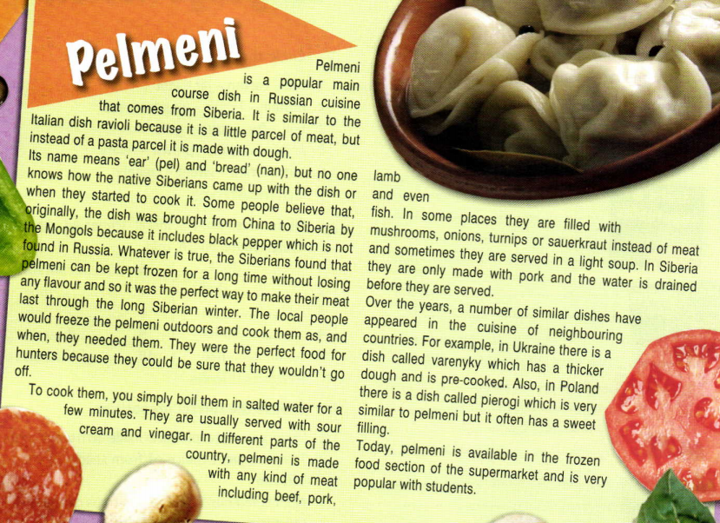
Read the text at p.40

Slide 4

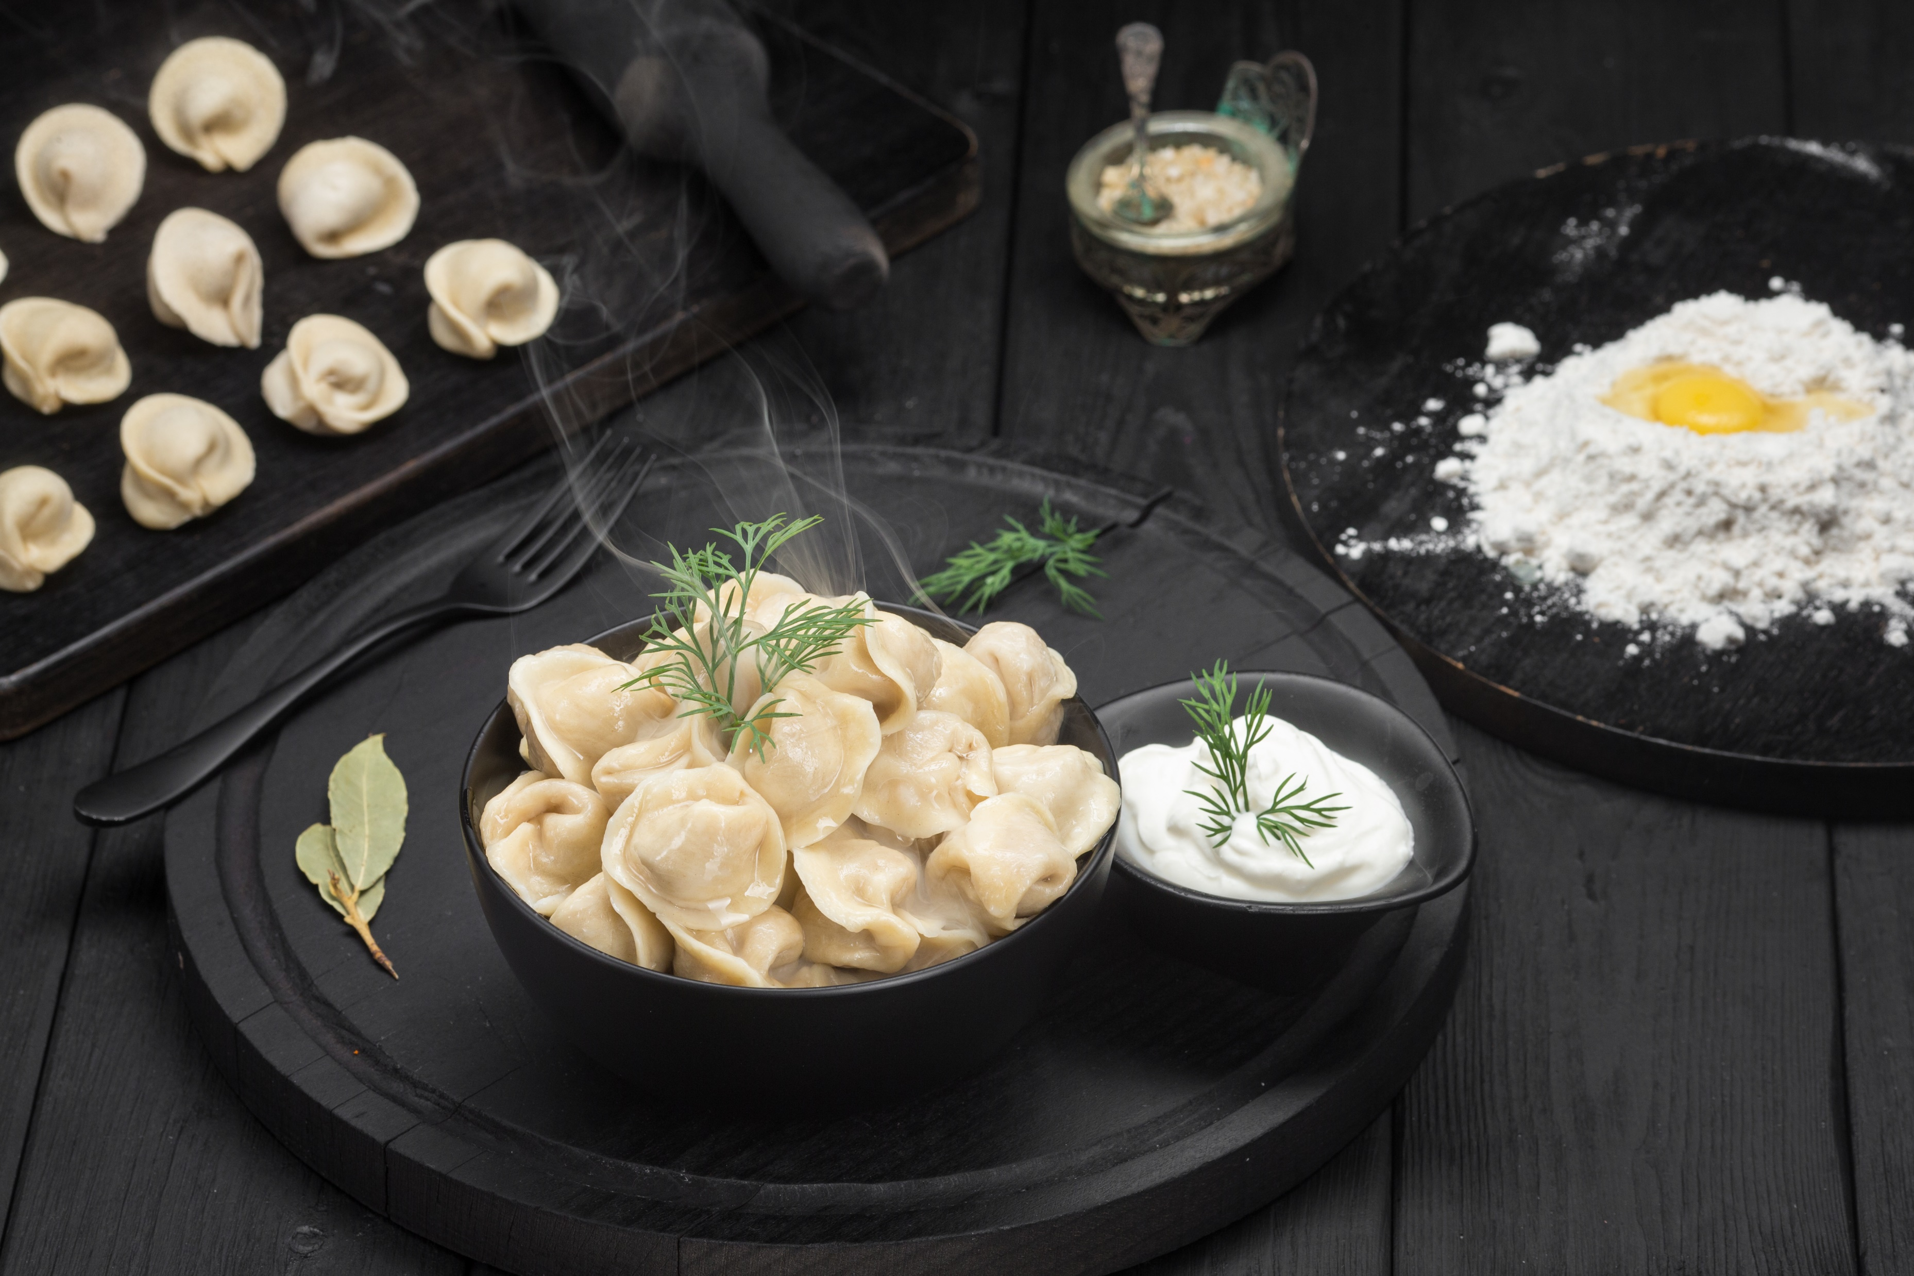
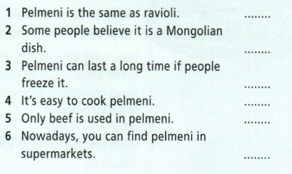
1.
F
F
T
T
F
T
2. Follow the link an do the task.
https://wordwall.net/ru/resource/7594702/food

Slide 5
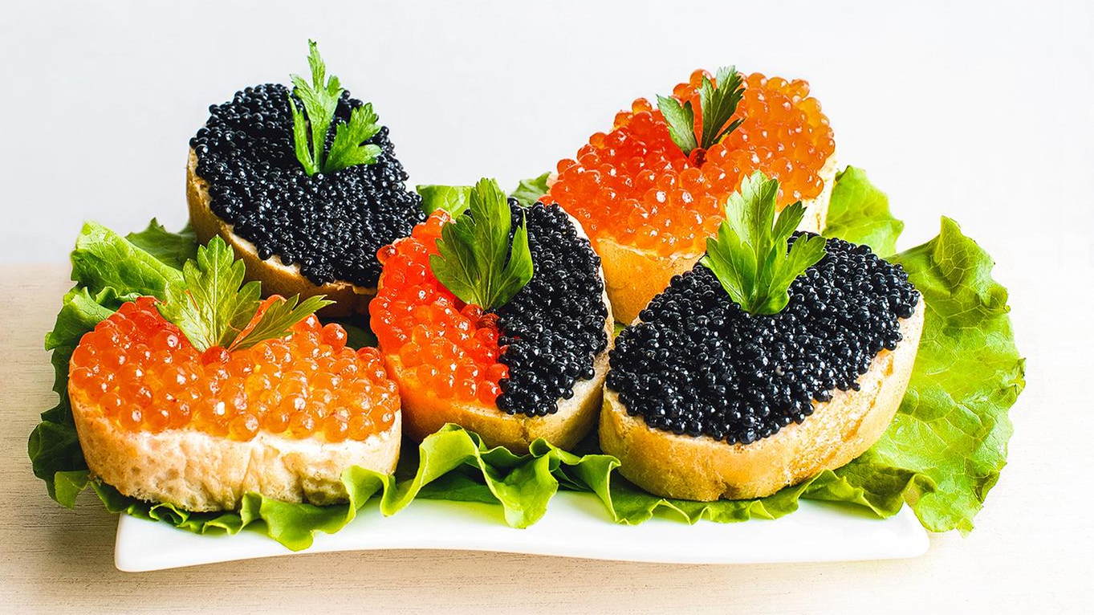
Caviar

Slide 6
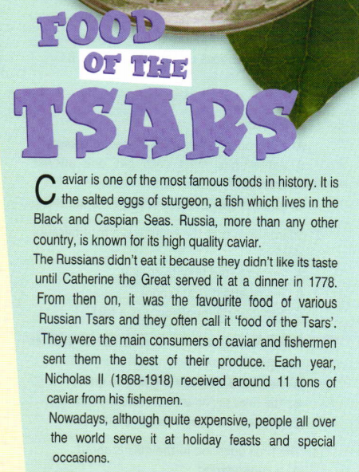

What is caviar? Why is it called “food of the Tsars”?
Listen and read the text at p.42

Slide 7
Answer the questions.
1) Where does caviar come from?
2) Why didn’t the Russians like it originally?
3) When did caviar become a delicacy?
4) When do people eat caviar nowadays?
H.T.: find out the information about traditional Russian food/dish and present it to the class.

